Slide 1
Variables
Notes:
Learning Objective: I can describe what a variable is and began to understand how to use them to record data.

Slide 2
Variable
Notes:
Introduce students to key vocabulary for this lesson:
Variable: A variable is a simple way of storing one piece of information somewhere in the computer’s memory whilst a program is running, and of getting that information back later.

Slide 3
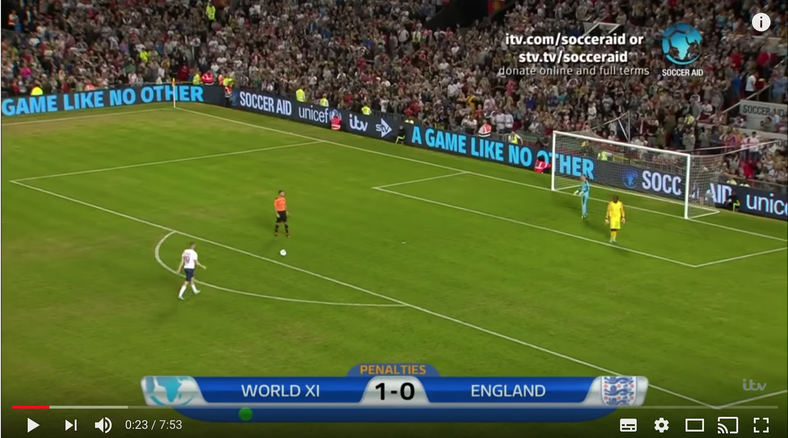
Total =
Notes:
Click on the link above, watch the teams/players take part in a penalty shootout, ask students to think about what is important and what needs to be recorded?
The score (the total which is ongoing and updated when a team scores a goal)
The team (The name of the team and who scores the goal)
Explain that these will act as variables to keep track of the score. How we will know which score each pupil is keeping track of? They can write the name of the team on the top of the table just as we name variables in a computer program
Ask students to use logical reasoning to work out when does the game end? How will we know who wins? (These are rule-based algorithms which will describe the game).
As you and you class watch the video mark the penalties scored and change the totals each time.

Slide 4
A variable stores a piece of information in a computer’s memory while a program is running, that can be retrieved when needed.
Notes:
Explain the concept of a variable.
A variable stores a piece of information in a computer’s memory while a program is running, that can be retrieved when needed.
A variable is an example of a data structure. As pupils move on to secondary school, they will learn about other data structures such as arrays.
A variable can be a number or text or perhaps true/false.
Programs can store, retrieve or change the values of variables. Variables are an abstraction of data storage and retrieval: as programmers, we need not know how exactly the programming language, operating system and hardware manage and handle them.

Slide 5
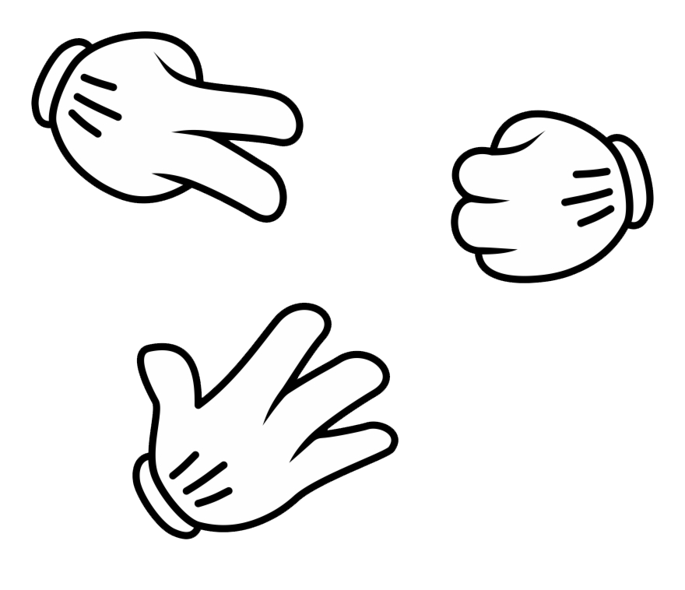
Rock, Paper, Scissors
Total =
Notes:
Explain to students they are going to play a game of rock, paper scissors.
Ask your students what variables are there within the game?
Provide your students with a whiteboard and pen, ask you students to talk about how they could make a record of who wins a game? (Example above of table with 2 columns with names of the player that has an option to add a tick, or X or just a point).
Explain that these are variables to keep track of the score.
• Lead a discussion to decide how many points each player should get when they win a round, how will we know when to stop the game? (These are rule-based algorithms which will describe the game).
Play the game remembering to add the score and to keep changing the total score.

Slide 6
How did you show whose score you were keeping track of?
Explain what you did when your player scored a point?
How could you tell how many points your player had?
How else were the values in the variables used?
Did this alter the values in the variable?
When you started a game what was stored in the variable? Why?
Notes:
With your students explore these questions.
How did you show whose score you were keeping track of?
Explain what you did when your player scored a point?
How could you tell how many points your player had?
How else were the values in the variables used?
Did this alter the values in the variable?
When you started a game what was stored in the variable? Why?

